Slide 1
Parameters in ADMB

Slide 2
Specifying model parameters
 | Unbounded | Description
Estimated | init_number theta; | Estimate parameter theta
Fixed | init_number theta(-1); | Keep parameter theta at initial value
Phases | init_number theta(2); | Estimate parameter theta in second phase
 | Bounded | Description
Estimated | init_bounded_number p(0,1); | Estimate parameter p between 0 and 1
Fixed | init_bounded_number p(0,1,-1); | Keep parameter p at initial value
Phases | init_bounded_number p(0,1,2); | Estimate parameter p between 0 and 1 in second phase

Slide 3
Specifying vector of model parameters
 | Unbounded | Description
Estimated | init_vector theta(1,3); | Estimate 3 parameters theta indexed from 1 to 3
Fixed | init_vector theta(1,3,-1); | Keep 3 parameters theta at initial values, indexed from 1 to 3
Phases | init_vector theta(1,3,2); | Estimate 3 parameters theta in second phase, indexed from 1 to 3
 | Bounded | Description
Estimated | init_bounded_vector p(0,5,-1,3); | Estimate 6 parameters p indexed between 0 and 5 and bounded between -1 and 3
Fixed | init_bounded_vector p(0,5,-1,3,-1); | Keep 6 parameters p at initial values between -1 and 3, indexed from 0 to 5
Phases | init_bounded_number p(0,5,-1,3,2); | Estimate 6 parameters p indexed between 0 and 5 bounded between -1 and 3 in second phase

Slide 4
Other parameter vector types
 | Sum to 0 | Description
Estimated | init_bounded_dev_vector eps(1,20,-10,10); | Estimate 20 parameters eps between -10 and 10 sum to zero
Fixed | init_bounded_dev_vector eps(1,20,-10,10, -1); | Keep 20 parameters at initial values
Phases | init_bounded_dev_vector eps(1,20,-10,10, 2); | Estimate 20 parameters eps between -10 and 10 sum to zero in second phase
 | Individual parameters | Description
Estimated | init_number_vector delta(1,3); | Estimate 3 individual parameters indexed 1 through 3
Fixed | init_number_vector delta(1,3,-1); | Fix 3 individual parameters indexed 1 through 3
Phases | init_number_vector delta(1,3,2); | Estimate 3 individual parameters indexed 1 through 3 in second phase
Individual parameters may be useful as error terms
Also init_bounded_number_vector following same rules as other bounded vectors

Slide 5
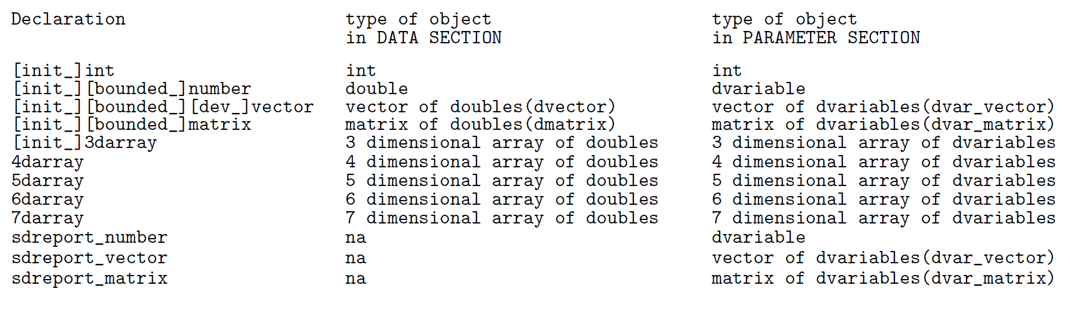
Declarations in DATA vs. PARAMETER sections
PARAMETER_SECTION Rules
Everything starting with init_ is optimized
Everything starting with sdreport_ estimates standard errors and correlations
Other number, vector, matrix, etc. variables store intermediate calculations

Slide 6
Initializing parameters
INITIALIZATION_SECTION
PARAMETER SECTION
init_bounded_number_vector p(1,3,lb,ub,phase);
objective_function_value nll
INITIALIZATION_SECTION
p 1;

Slide 7
Initializing parameters
2) .PIN file
Set up like .DAT file
Parameters are in the same order as the parameter section
Overwrites INITIALIZATION_SECTION
#p
4 2 1.5

Slide 8
Initializing parameters
3) PRELIMINARY_CALCS_SECTION
Overwrites .PIN file and INITIALIZATION_SECTION
PARAMETER SECTION
init_bounded_number_vector p(1,3,lb,ub,phase);
objective_function_value nll
PRELIMINARY_CALCS_SECTION
p(1) = 2;
p(2) = 2;
p(3) = 2;

Slide 9
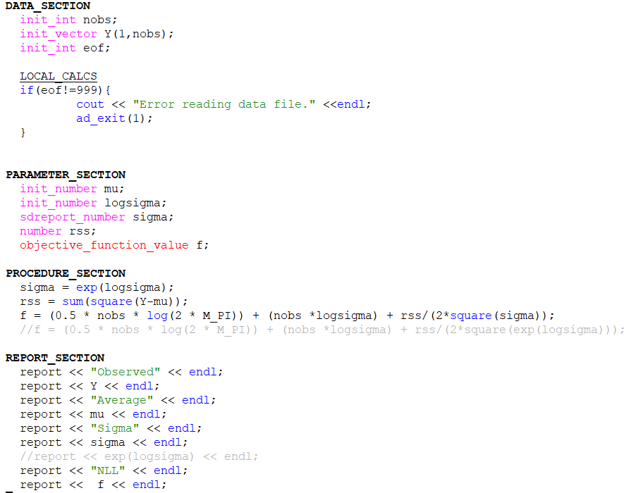
Transformations
Sometimes we need or prefer transformations instead of bounded optimization
Example: we know sigma is positive, but we don’t know the upper limit
With transformed variable we can calculate confidence interval around sigma while keeping everything positive

Slide 10
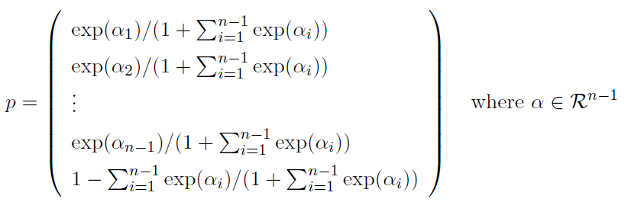

Transformations: probability vector
Single probability vector: can use inverse logit transformation
Probability vector $p=\left(p_{1},…,p_{n}\right)∈{\left[0,1\right]}^{n}$ with $\sum{p}=1$ can use transformation:

Slide 11
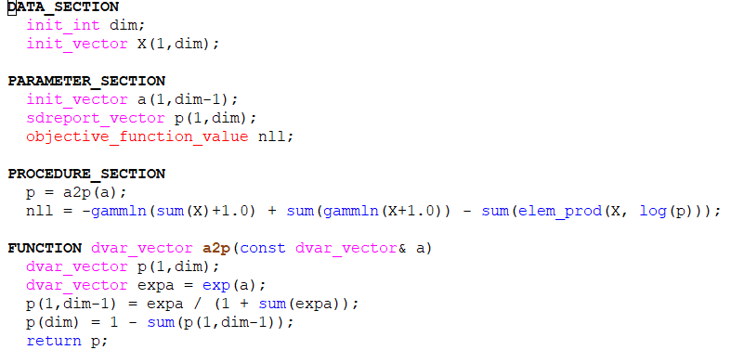
Transformations: probability vector

Slide 12
Exercises
Suggest how to use bounds and/or transformation to parameterize a parameter that is:
Only negative
Between 2 and 5
An increasing vector

Slide 13


Exercises
Solutions:
Only negative
Between 2 and 5
An increasing vector

